Slide 1
Building, Testing, and Deploying with the CLI

Slide 2


Slide 3

Overview
Module Overview
Generating a new Angular app (ng new)
Serving the application (ng serve)
Generating code (ng generate)
Testing the application (ng test/e2e)
Building the application (ng build)

Slide 4

Angular CLI Overview
A command line interface for Angular
Purpose:
Build an Angular application
Generate Angular files
Build and serve the application
Run unit and end to end tests
Prepare the application for deployment

Slide 5
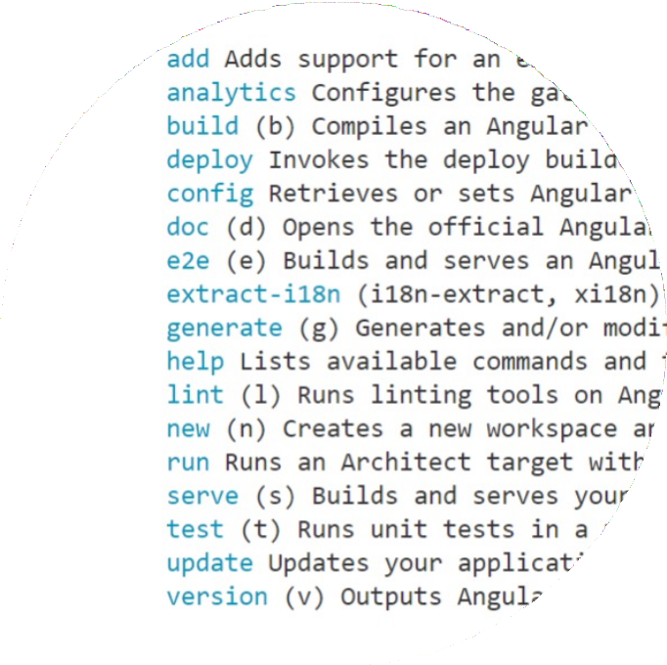
Angular CLI Command Syntax
ng <command> <args> --<options>
ng new hello-world --prefix hw

Slide 6
Angular CLI
Global Angular CLI
projects/apm
projects/hello-world
projects/cms
Local Angular CLI
Local Angular CLI
Local Angular CLI

Slide 7

Installing the Angular CLI
npm install -g @angular/cli

Slide 8

Demo
Generate a new Angular application (ng new)
Examine the generated files

Slide 9





Serving the Application (ng serve)
Compiles the application
Generates application bundles Starts a local web server
Serves the application from memory Rebuilds on file changes

Slide 10
Generating Code (ng generate)
Welcome Component
index.html
App Component
Users List Component
User Detail Component
User Service

Slide 11
Schematic
A template-based code generator that supports complex logic.
It is a set of instructions for transforming a software project by generating or modifying code.
Angular documentation: https://angular.io/guide/schematics

Slide 12

Components (ng | g | c <name>)
Directives (ng g | d | <name>)
Route guards (ng | g | g <name>)
Interfaces (ng g | i | <name>)
Modules (ng g m <name>)
Pipes (ng g p <name>)
Services (ng g s <name>)

Slide 13
Demo
Testing the application
ng test ng e2e

Slide 14
Demo
Building the application (ng build)

Slide 15
ng update
Reference: https://angular.io/cli/update

Slide 16
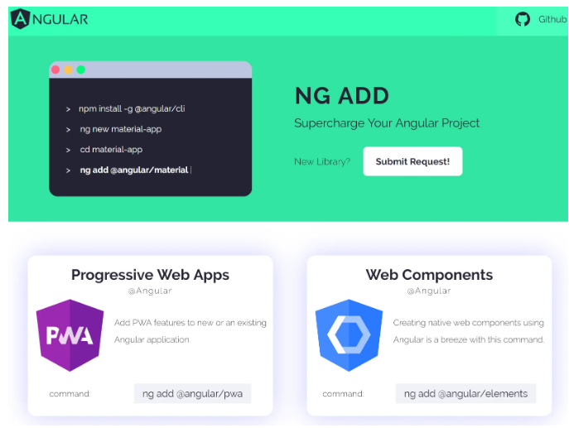
ng add
Reference: https://www.angularjswiki.com/angularcli/ng-add/#:~:text=ng%20add%20will%20use%20our,scaffold%20package%2Dspecific%20initialization%20code.

Slide 17
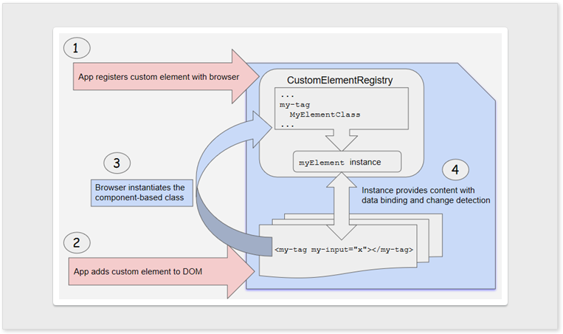
Angular Elements
Reference: https://angular.io/guide/elements

Slide 18
Updates to @angular/material
Reference: https://update.angular.io/?v=9.0-14.0,
https://www.educba.com/angular-material-version/

Slide 19
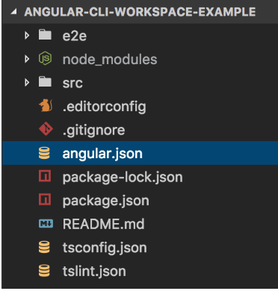
CLI workspaces and Libraries
Reference: https://angular.io/guide/file-structure

Slide 20

Tree Shakeable Providers

Slide 21
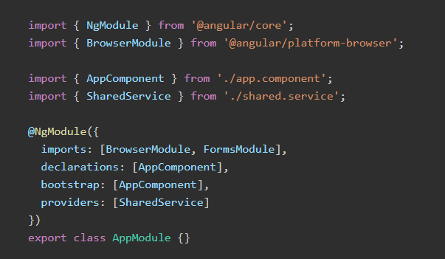
Registering a Service in previous Angular versions

Slide 22
Registering a Service in previous Angular versions

Slide 23
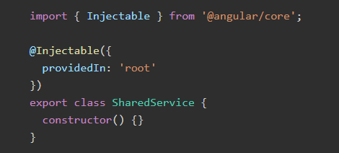
Angular Tree Shaking Providers

Slide 24
Demo
Tree Shakeable Providers

Slide 25

Angular CLI Checklist: Commands
ng help - Displays available commands
ng new - Creates a new Angular application
ng serve - Builds the app and launches a server ng generate - Generates code
ng add - Adds support for an external library to the app
ng test - Runs unit tests
ng e2e - Runs end-to-end tests
ng build - Compiles into an output directory ng deploy - Deploys the application
ng update - Updates the Angular version for the app

Slide 26
Angular CLI Checklist:
ng generate
Commands
class component directive enum guard interface module pipe service
ng g cl
ng g c ng g d ng g e ng g g ng g i ng g m ng g p ng g s

Slide 27

Coming up next …
Introduction to TemplateDriven Forms

